Slide 1

Welcome to
Mitko.Vtori World

Slide 2


What is Mitko.Vtori World?
◉ This is a company created by Dimitar Dimitrov
◉ The main idea is to share code and do fun projects
◉ Everything started with this website
You can see the company’s open source code at GitHub:
https://github.com/Mitko-Vtori-World
https://Mitko.Vtori-World/

Slide 3

Meet our workers

Slide 4
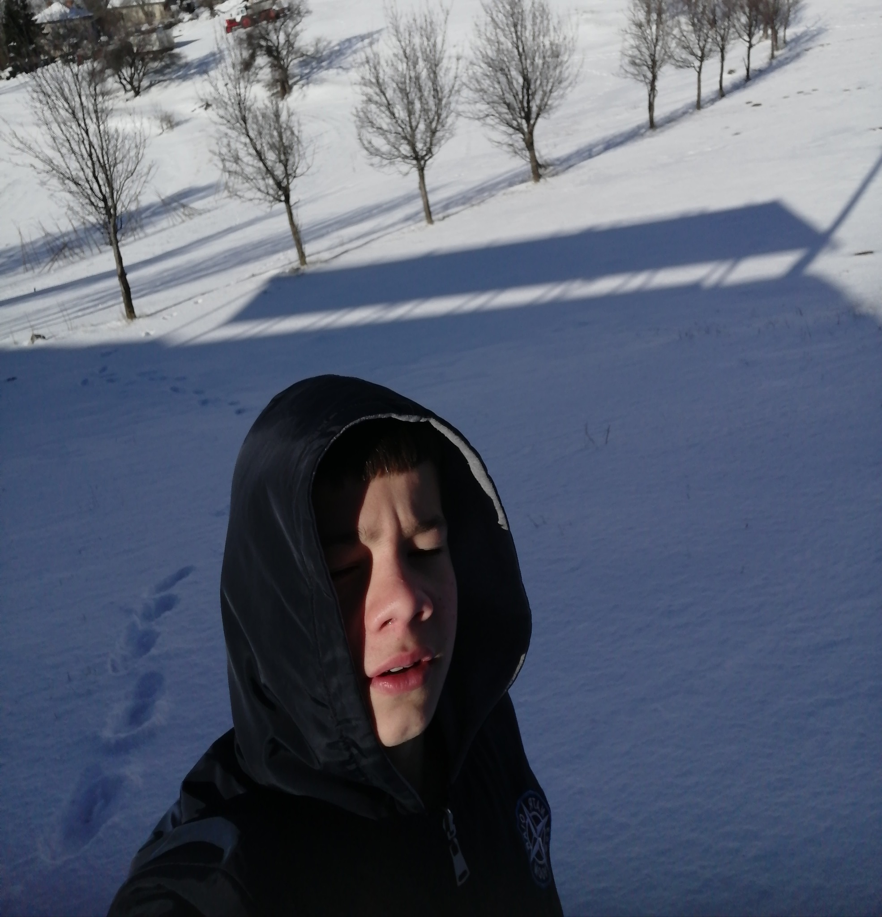
Dimitar Dimitrov
Owner
Student at Software University: Learning Python
Have basics knowledge in programming
10+ Years of Football, boxing, Survival & lots of sports
Middle English speaker-B2.3
Interested in Full Stack Web Developing
Every week he is in different city!
Future Software Engineer!
GitHub: github.com/MitkoVtori
https://mitko.vtori-world/

Slide 5
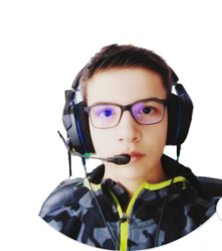
Yoan Stoyanov
Design
&
Administration
Live In Germany
Polyglot(speaking more than three languages)
Learning Software design
Have a little bit knowledge in JS …
GitHub: github.com/HackerstoyanovBG
https://Mitko.Vtori-World/

Slide 6

Currently Hiring!
Apply here: mitko.vtori@gmail.com
Apply here: mitko.vtori@gmail.com
Searching for someone who:
Have basic knowledge in HTML & CSS
Have TeamWork Skills
Is Creative
Speak English and/or Bulgarian
Can work for FREE
Know how to use GitHub
https://Mitko.Vtori-World/

Slide 7






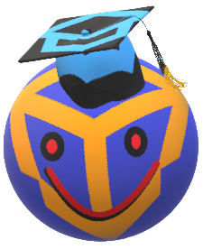
Introduction to our website

Slide 8
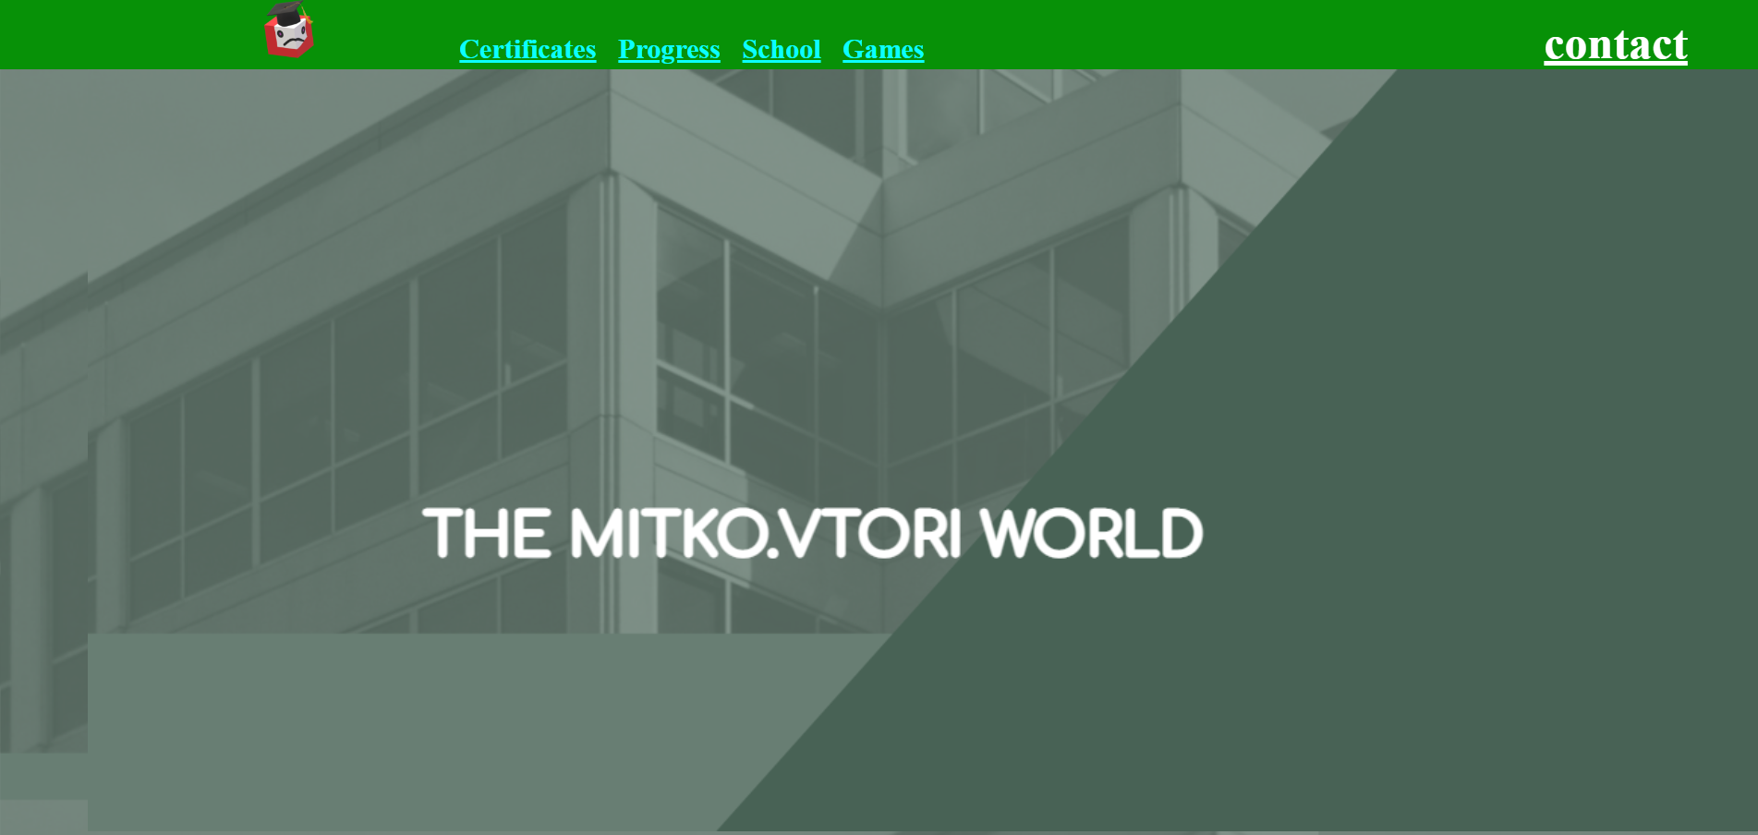
Main Page
In every page by clicking this logo you’ll be send to the main page

Slide 9
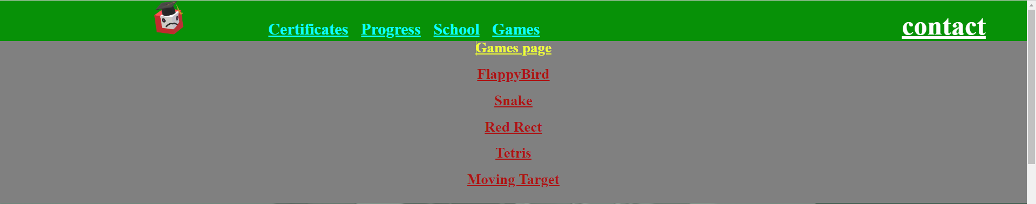

Sliding bar

Slide 10
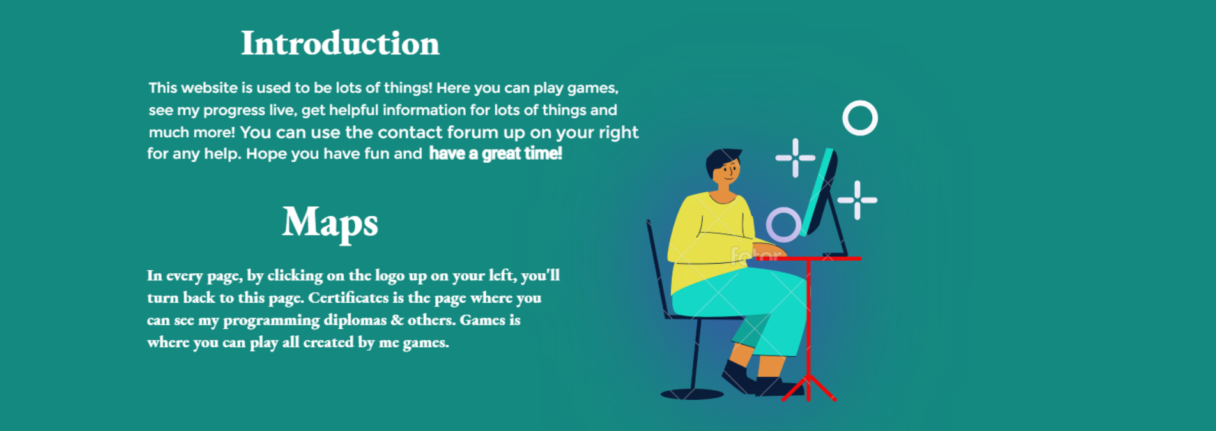

Slide 11

______
______
______

Slide 12

.
.
.
.

Slide 13
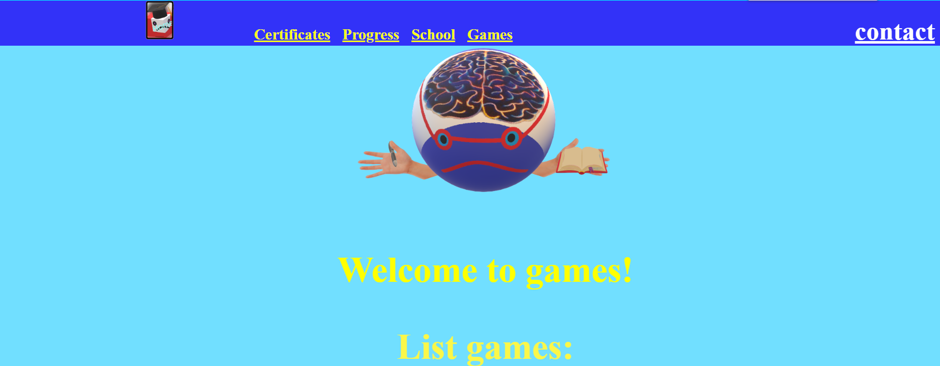
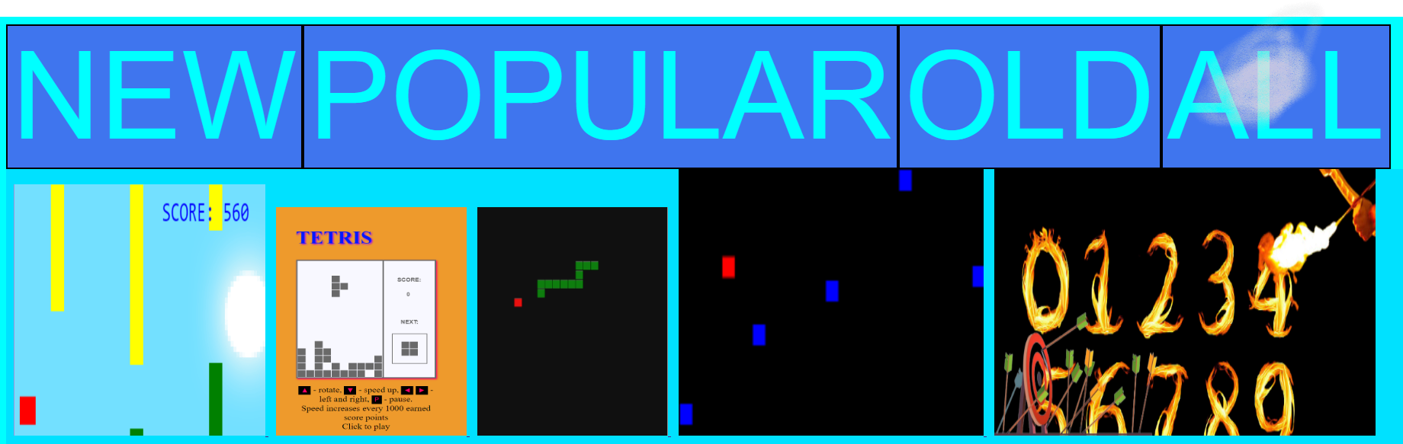
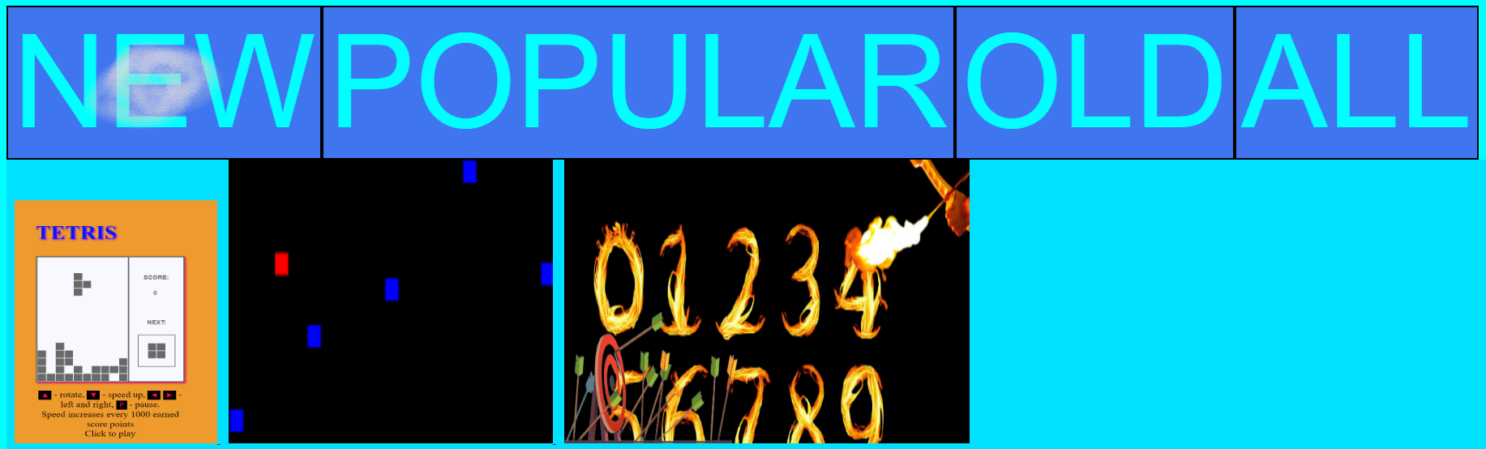
Games Page!
https://Mitko.Vtori-World/

Slide 14

WHY ARE YOU STILL HERE!?
Go explore our site before you miss something!
https://mitkovtori.github.io/Mitko.Vtori-World/
https://github.com/Mitko-Vtori-World
https://github.com/MitkoVtori/Mitko.Vtori-World
https://github.com/MitkoVtori
https://github.com/HackerstoyanovBG

